Slide 1
Agenda For today
Questions from ”readings”
Project Overview
Lab Overview

Slide 2
PCB Libraries: Packages, Symbols, and Devices
Dr. Steven Swanson
CSE176e/276e
swanson@cs.ucsd.edu

Slide 3
Designing for Correctness
Building correct libraries can be hard
It’s very easy to introduce bugs in your library
It can be very hard to find bugs in your library.
Your goal is to make it as easy as possible to verify your library’s correctness
Copy/mimic the datasheet as much as you can
Pin names
Pin order
Part orientation
This minimizes errors and makes it easy to check

Slide 4
PCB Libraries
To use a part on a PCB, you need a library entry for it
Physical/mechanical information for the board
Logical/electrical information for the schematic
Mapping between the two
Metadata
A well-designed library, makes your life much, much easier.
There are lots of libraries are the internet
Some are good, some are bad, some a poor match for what we need.

Slide 5
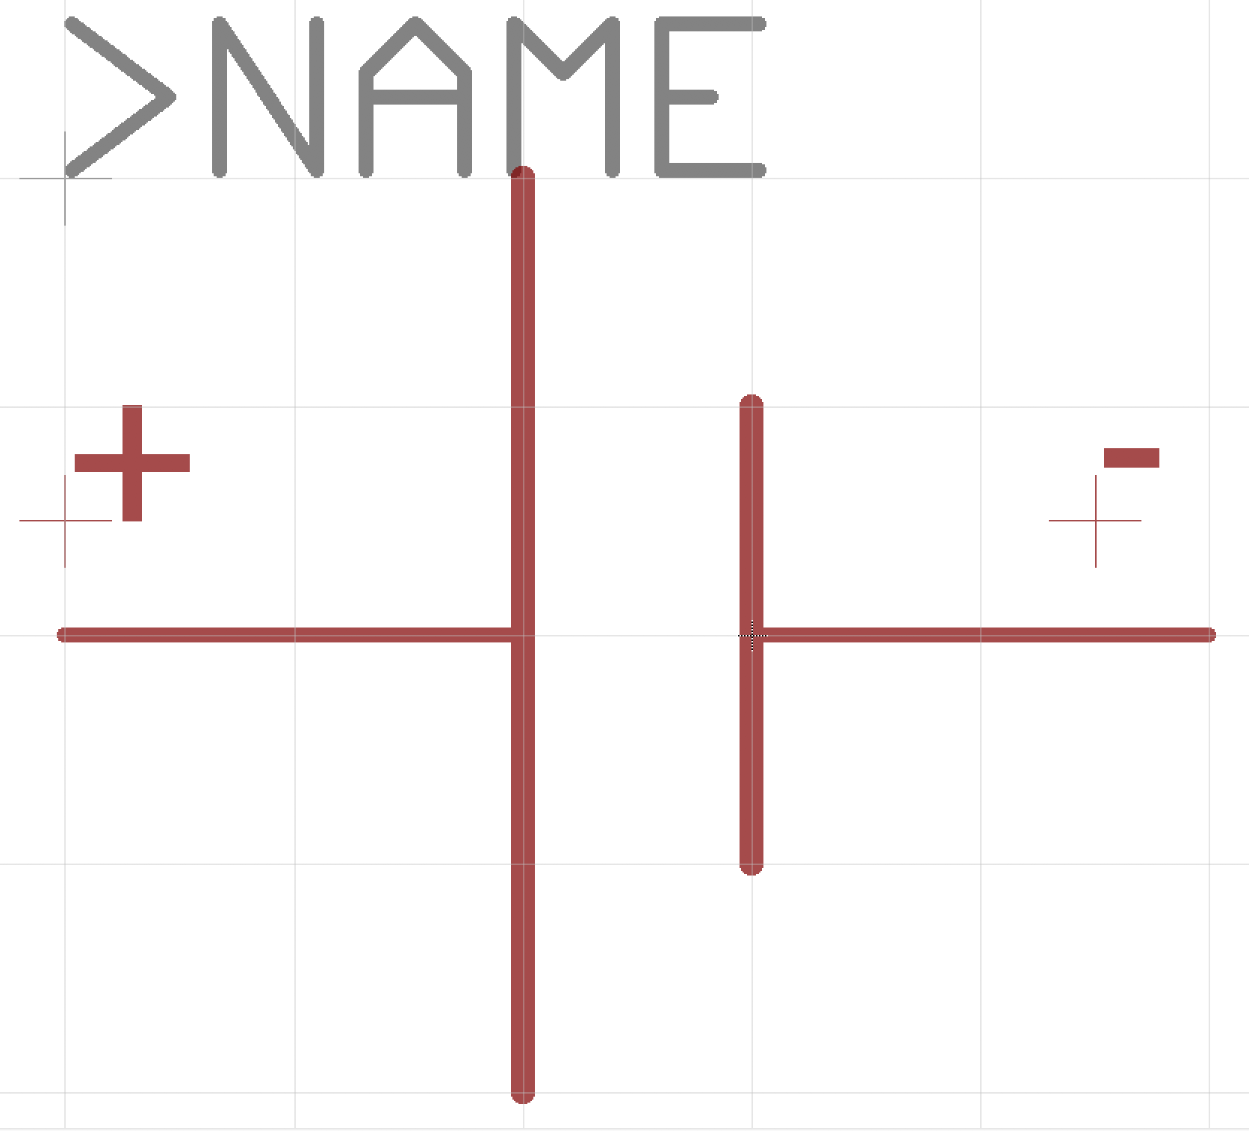
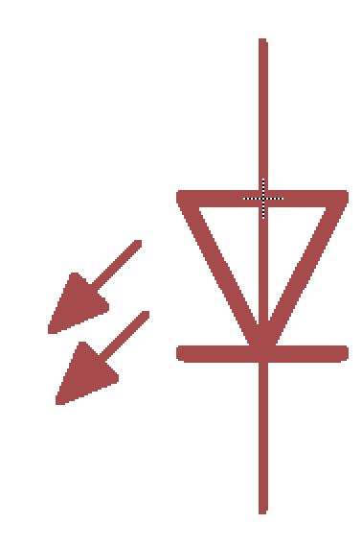
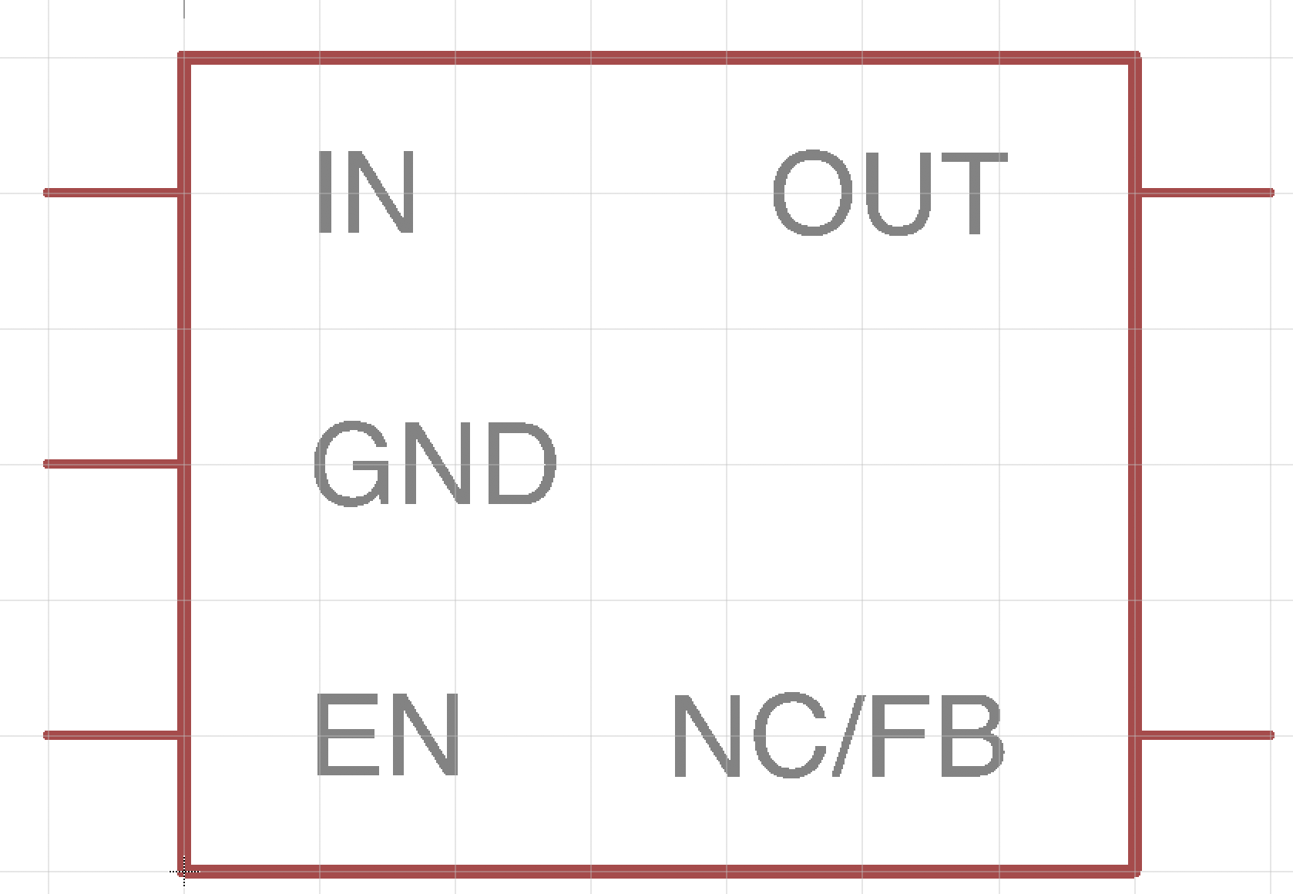
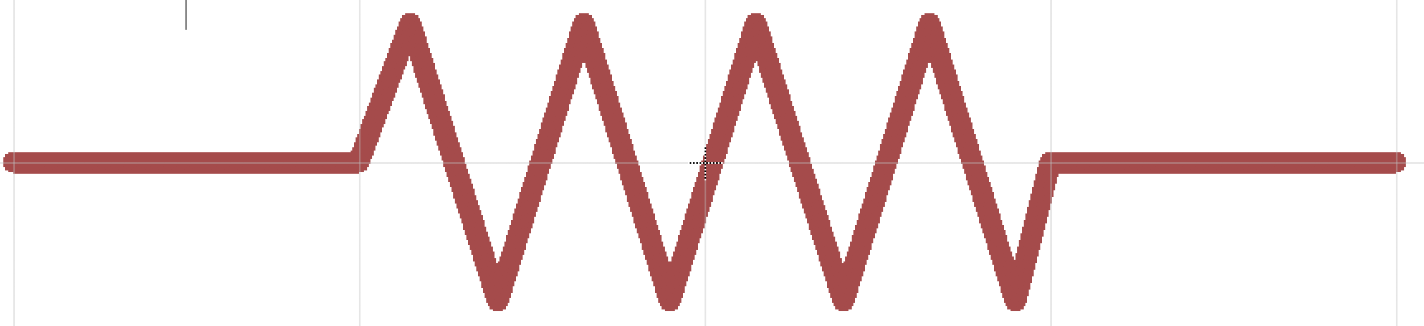
PCB Libraries: Symbols
Schematic representation of the component
Electrical connection points – “pins”
Generic symbols: resistors, capacitors, etc.
Specific symbols: e.g., Atmega128RF
Documentation, labels, etc.
Organized for ease of use and readability
Battery
Resistor
LED
Our voltage regulator

Slide 6
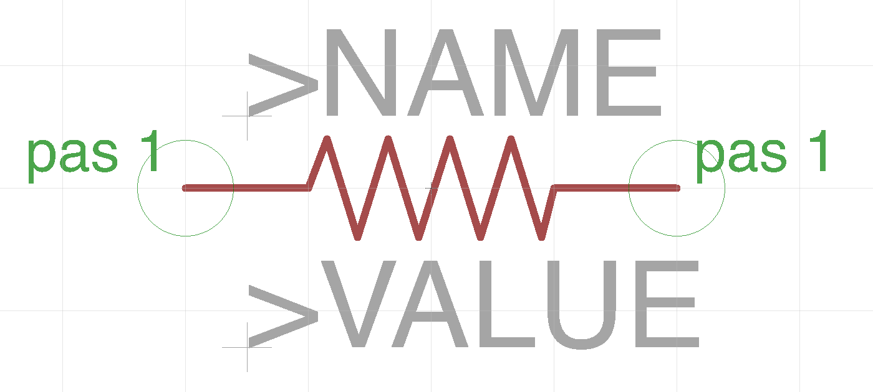
Example: A Resistor Symbol
Human-readable representation of the part
Has the standard resistor “zig zag”
Two ‘pins’
Pas 1
Pas 2
And place holders for documentation
>NAME – e.g. “R6”
>VALUE – e.g. “200Ohms”

Slide 7
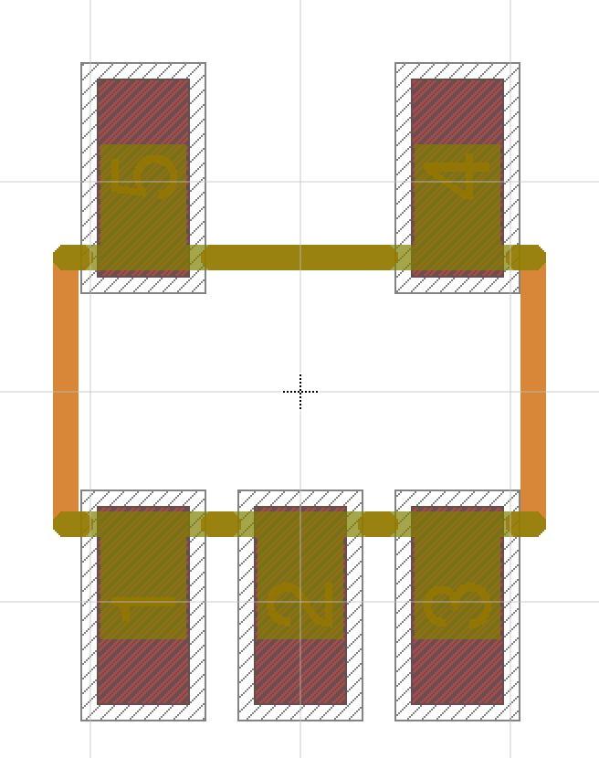
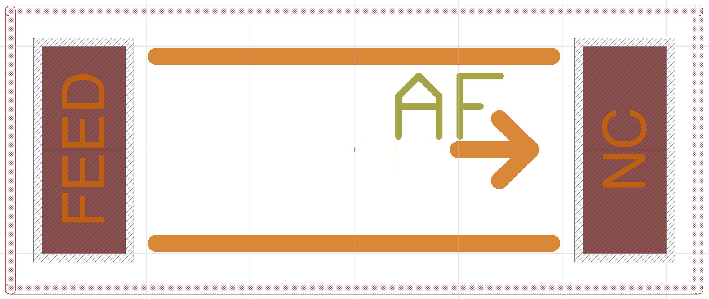
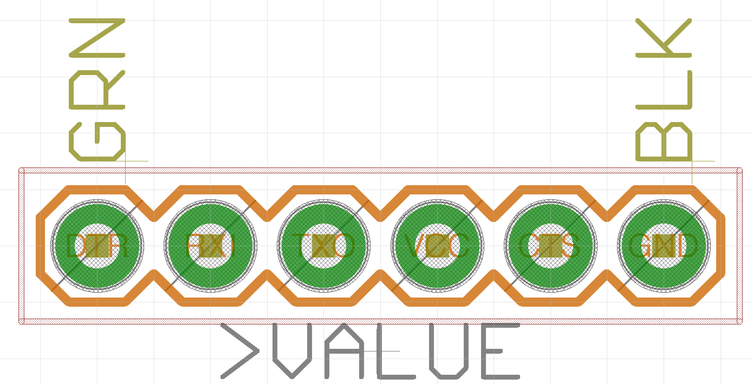
PCB Libraries: Packages
Mechanical description of the part
Electrical connections (i.e., pads and SMDs)
”keepouts” (i.e., the space the occupy)
Documentation (e.g., an outline to guide placement, reference designators, user documentation)
Generic packages
e.g., 0805 Resistor (there are 1000s of kinds of these)
Specific packages
e.g., Atmegat128RF (there’s just one kind)
An “chip” antenna
Standard SOT23 package
Programming Header

Slide 8
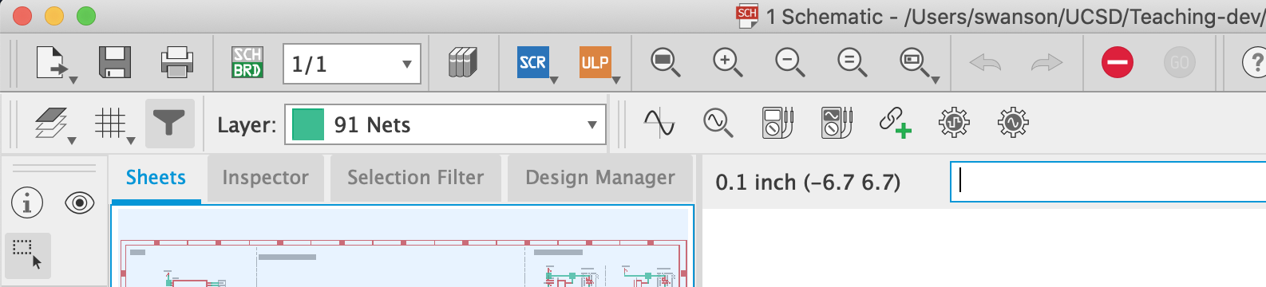
The Fusion360 Command Line
You can use your mouse to select tools in Fusion, but it’s slow.
Faster is to type commands using the command line
You can mouse of the tool pallet to get the command name
e.g., “move”, “copy”, ”info”, …
Then type ‘help <name>’ for help.
Or just type the name to select that tool.
This will save you hours over the course of the quarter.

Slide 9
Units
Units
We will mostly use mm in this class.
1mm is about 40mils (39.3700787, actually)
1in is exactly 25.4 mm.
Keep an eye on your units.
Exceptions
Fusion schematic symbols and schematics use inches
Lots of tutorials, documents, etc. use mils (1/1000 of an inch) or inches.
Breadboards and headers are typically 0.1” spacing (2.54mm)
Mars Climate Orbiter

Slide 10
Working with Units in Fusion
Use the “grid” tool (or command) to set grid Fusion will “snap” to.
‘grid mm’ -> switch to mm
‘grid 1’ -> make the grid 1 of the current unit

Slide 11
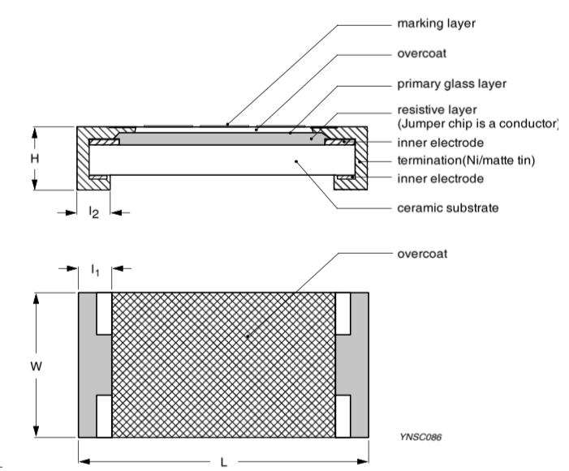
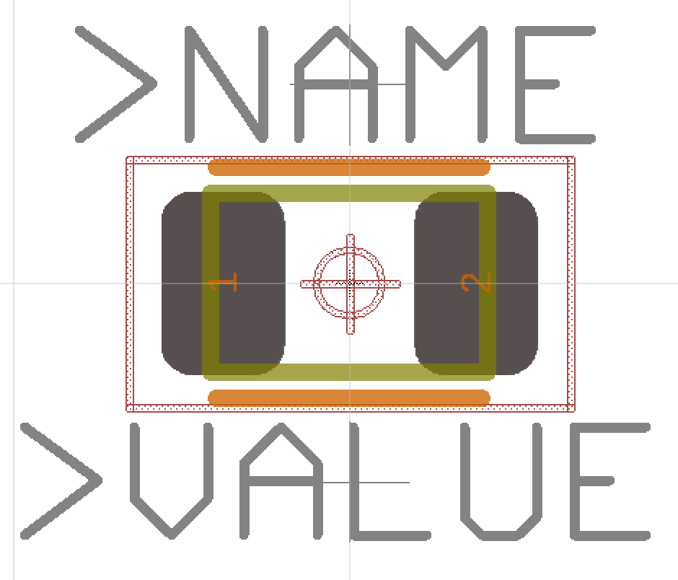
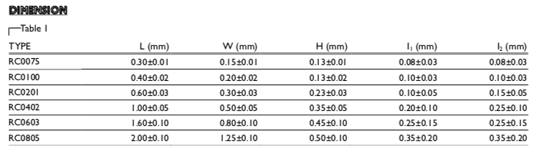
Example: A Resistor Package
Yageo RC Series SMD resistor
Package: 0805 (8mm x 5mm)
Pads
Extend out 1mm or so for easy soldering.
Keep out area (courtyard)
Where other parts should not be
Yageo makes these in many sizes 0075 (so tiny!) to 0805

Slide 12
Anatomy of a Package (Resistor)
Pins
Ex. “1” and “2”
Outline
In tDocu (gold)
Matches part shape precisely
Orientation/placement guidance
in tPlace (orange)
Varies by part.
Name
In tNames
Magic value “>NAME”
See lab for font size
Value
In tValues
Magic value “>VALUE”
See lab for font size
Keepouts
In tKeepout
Red shaded
Documentation
In tPlace
Other useful items

Slide 13
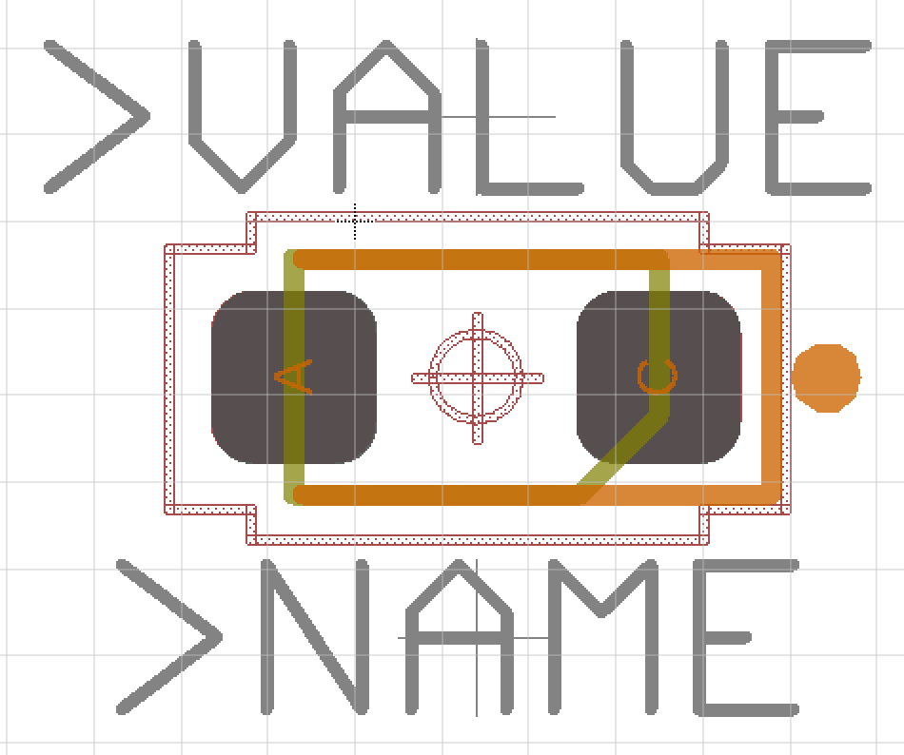
Anatomy of a Package (LED)
Same basic parts as a resistor.
But LEDs are not reversible.
Polarity marking
in tPlace (orange)
Mark pin 1

Slide 14
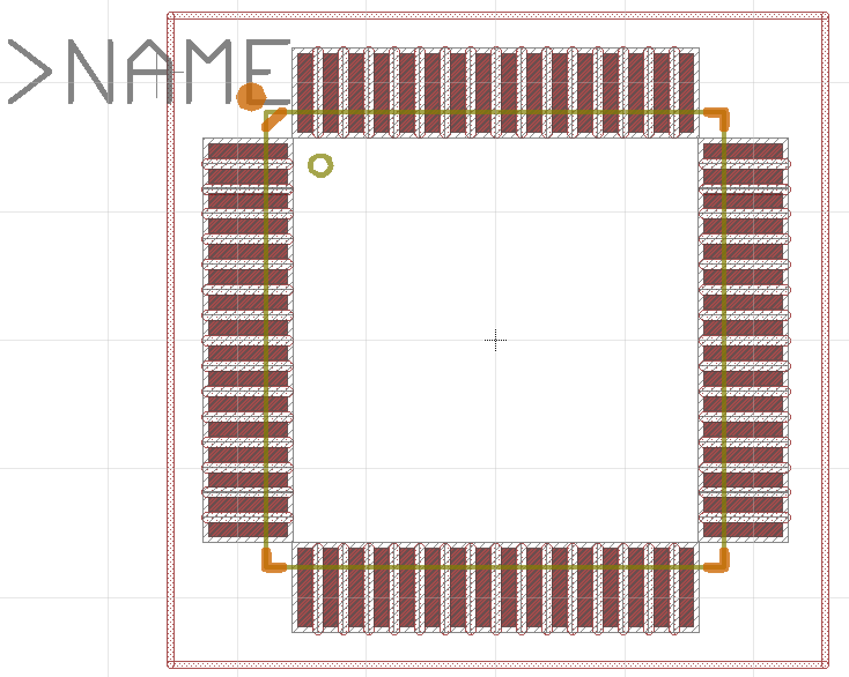
Anatomy of a Package (Microcontroller)
Same components, just more pins

Slide 15
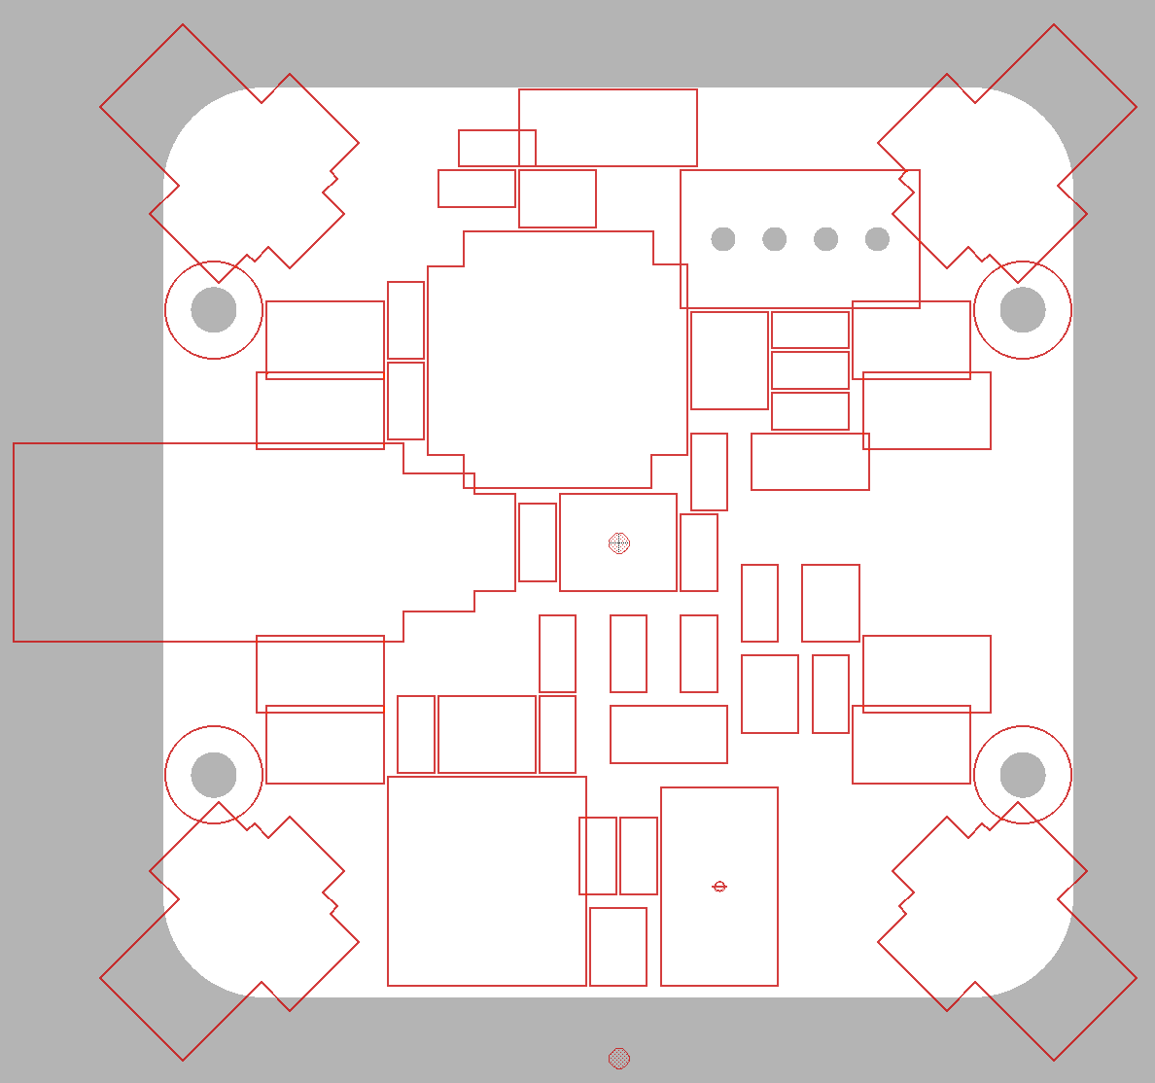
A Note about tKeepout
Carefully designed tKeepout + a 0.5 mm placement grid is what makes laying out the board easy(ish).
Draw tkeepout on a 0.5mm grid
Keep tkeepout lines i.e., more than 1.25 grid squares but less than 2.25 from the SMDs and package bodies (or so).
Don’t obsess about these numbers.
You can “hug” the pins and package if you want.
Then inset it by 0.1mm
Set grid 0.1mm and move each line segment in 0.1mm
Fiddly but worth it.

Slide 16
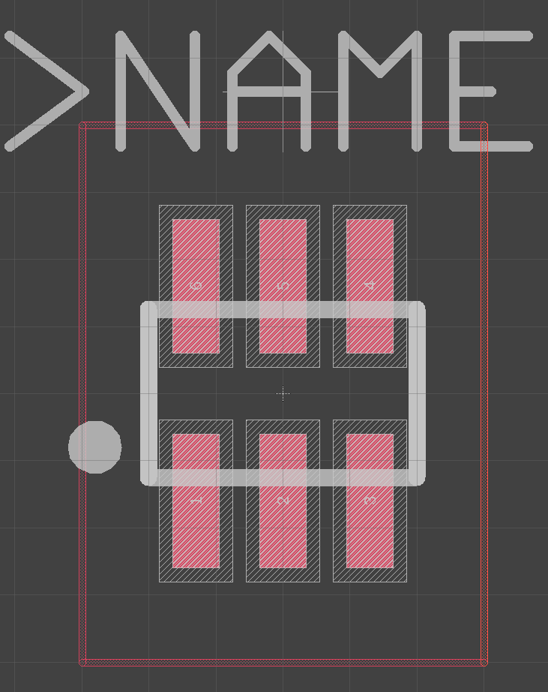
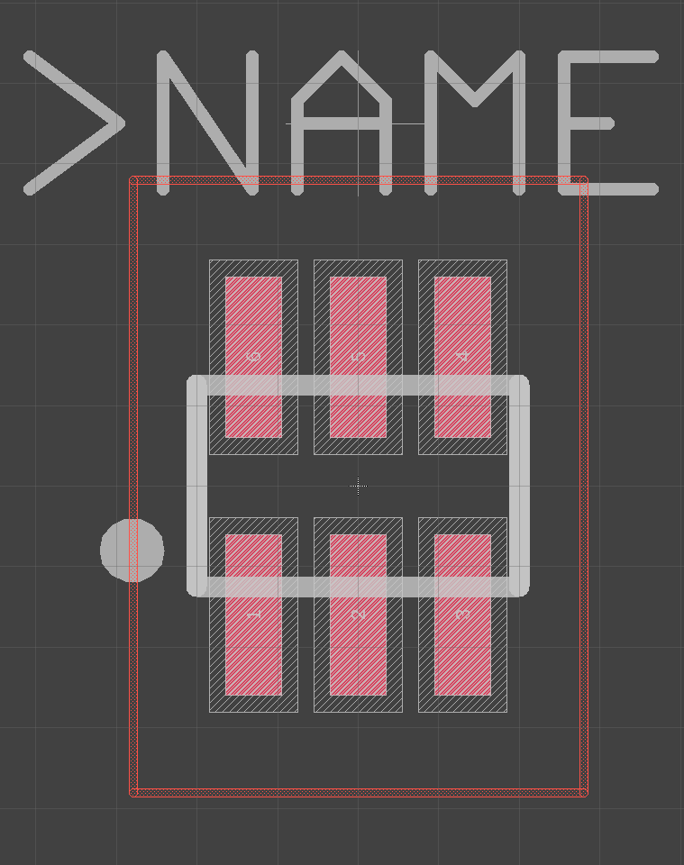
tKeepout Example
Initial layout
Inset

Slide 17
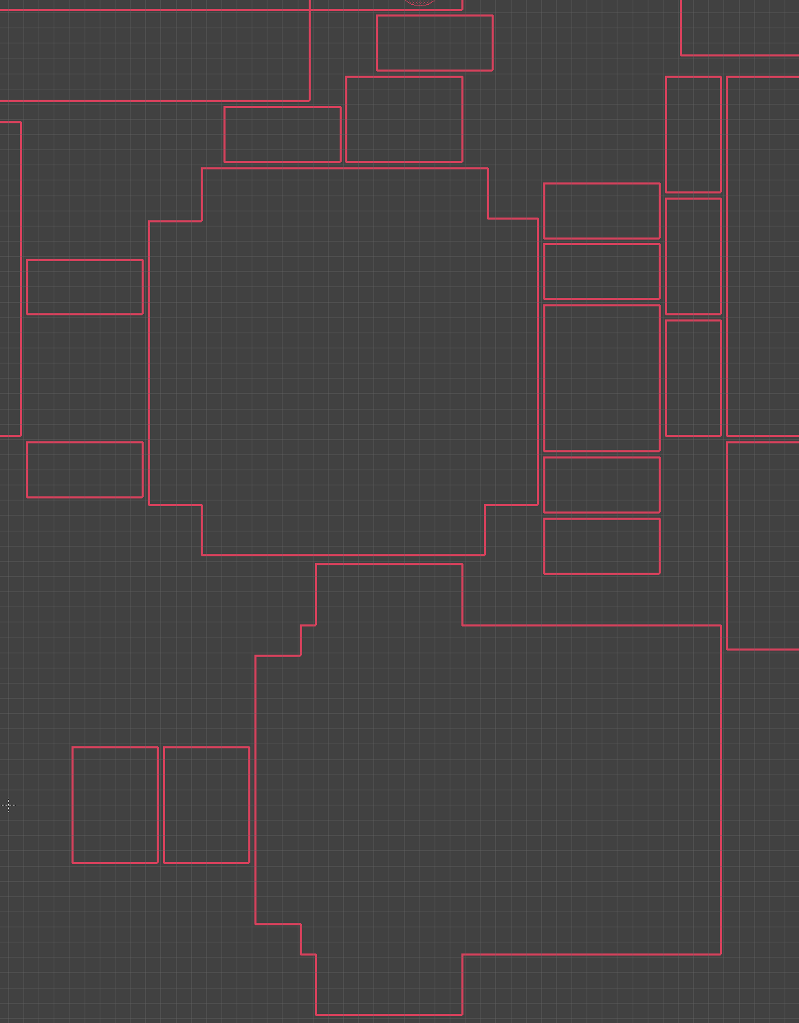
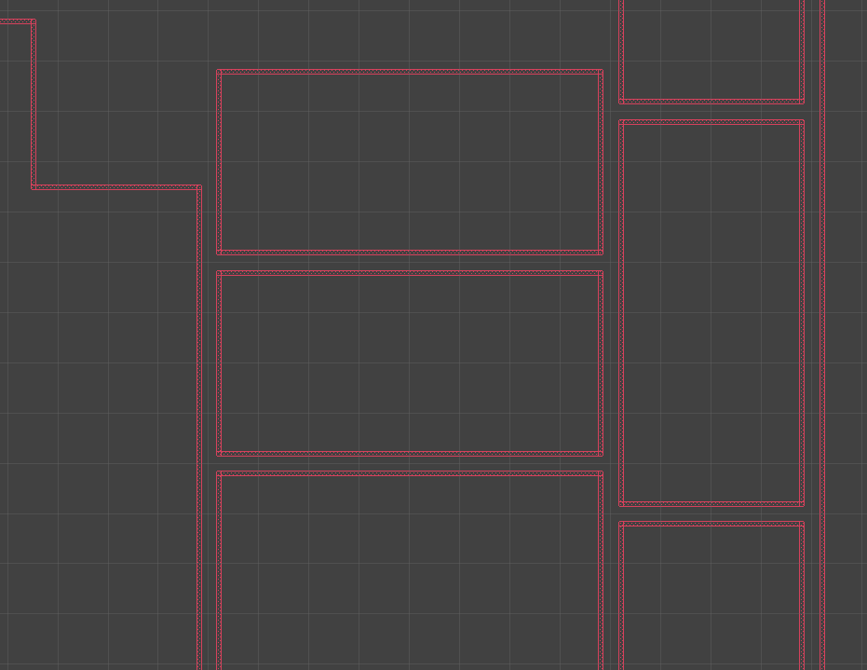
tKeepout Example

Slide 18
PCB Libraries: Devices and Variants
There is one “device” in a library for each kind of electrical component
Resistor
Capacitor
AtmegaRFA128 microcontroller
Each device can have several “variants” (Fusion term)
There’s one variant for each specific electrical component
Yageo AC0603JR-07510RL (510 Ohm resistor)
Yageo AC0603JR-072K2L (2.2KOhm resistor)
…
Variants are what you add to your design.

Slide 19
PCB Libraries: Devices & Variants
Devices map between
1 symbol
1 or more variant
A variant has
Name
Package
Pin mapping
Metadata
“attributes” -- e.g., manufacturer, part number, resistance, capacitance
Name prefix for reference designators -- e.g., the “R” in R1, R2, etc.
Does it have a “value”? (e.g., a resistor’s value is its resistance, but a microcontroller doesn’t have a value)

Slide 20
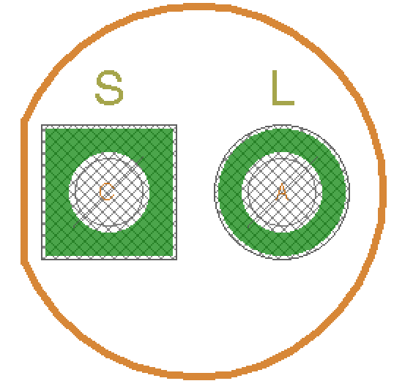
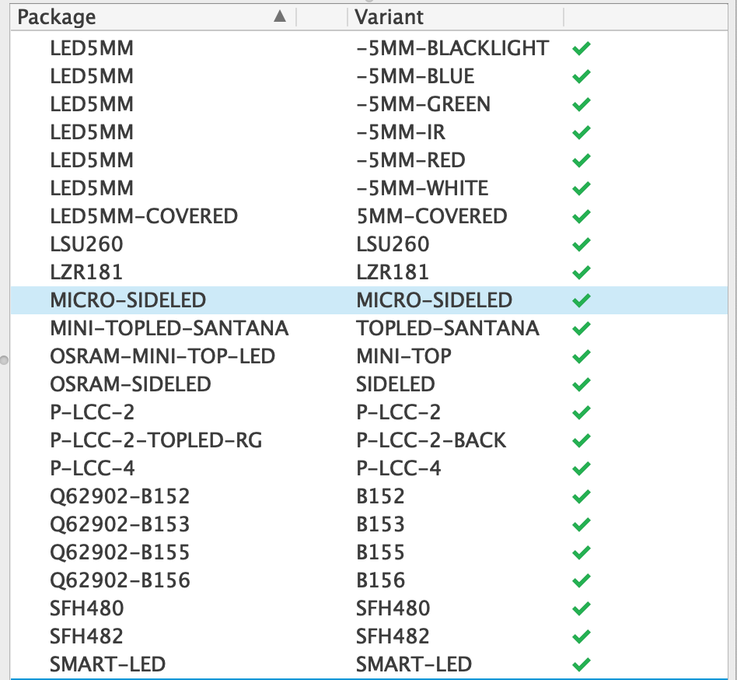
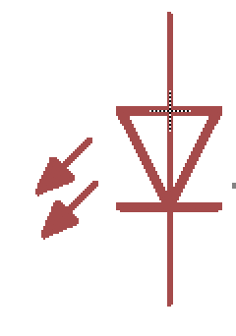
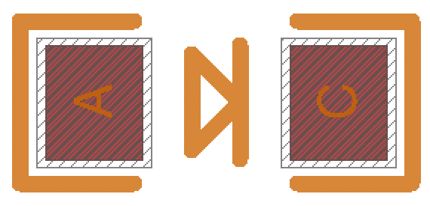
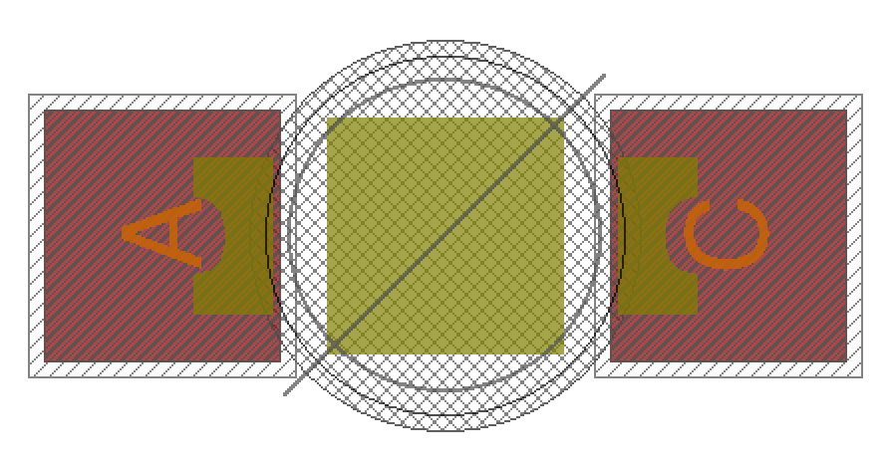
Device Example: LED
One Symbol
Many Packages
Many more variants

Slide 21
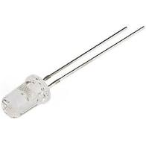
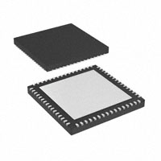
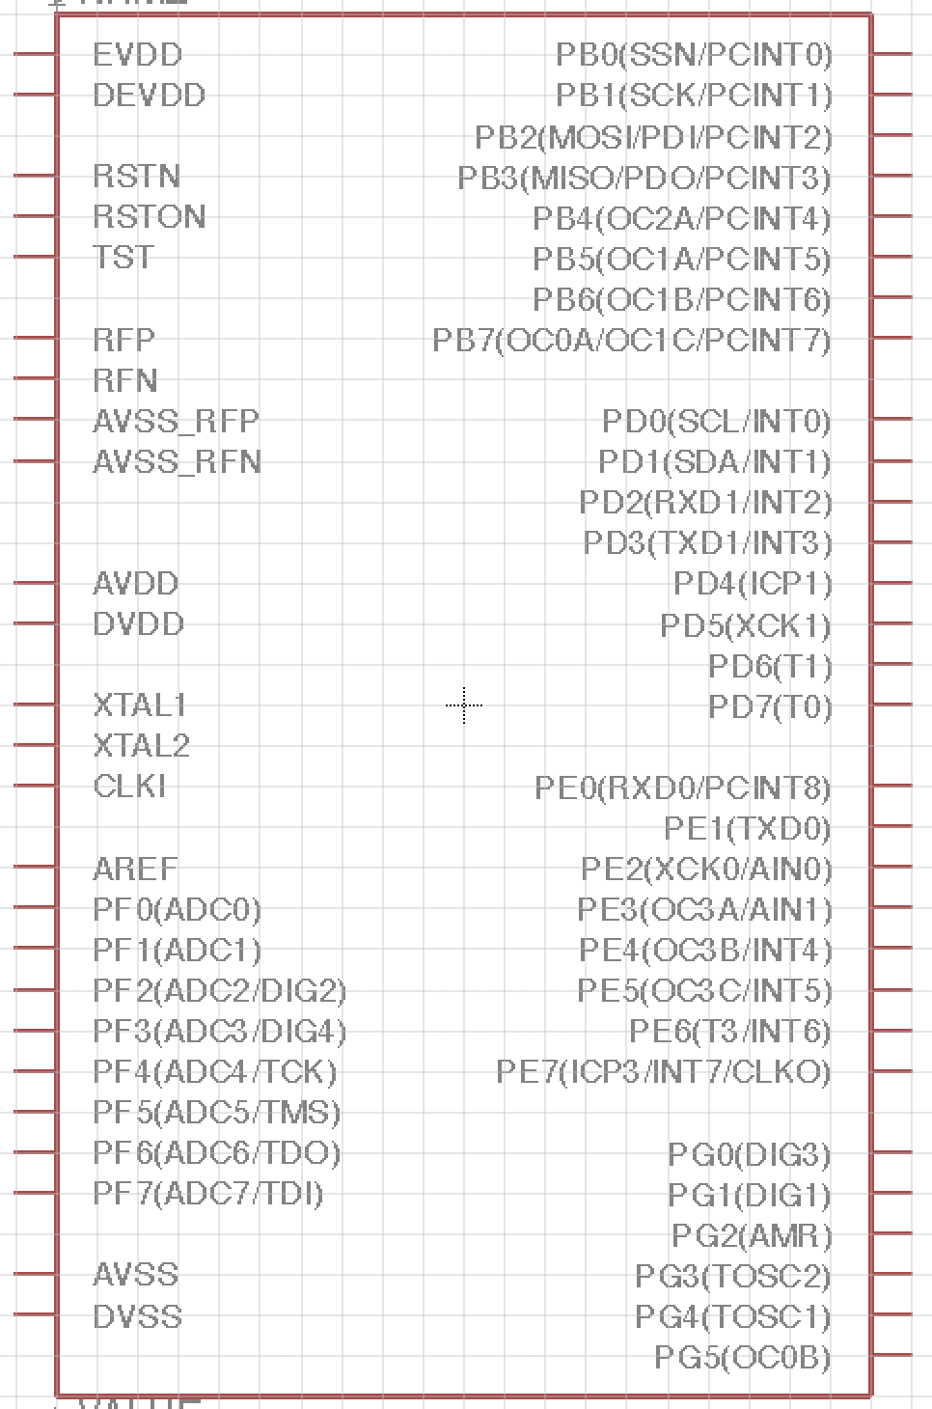
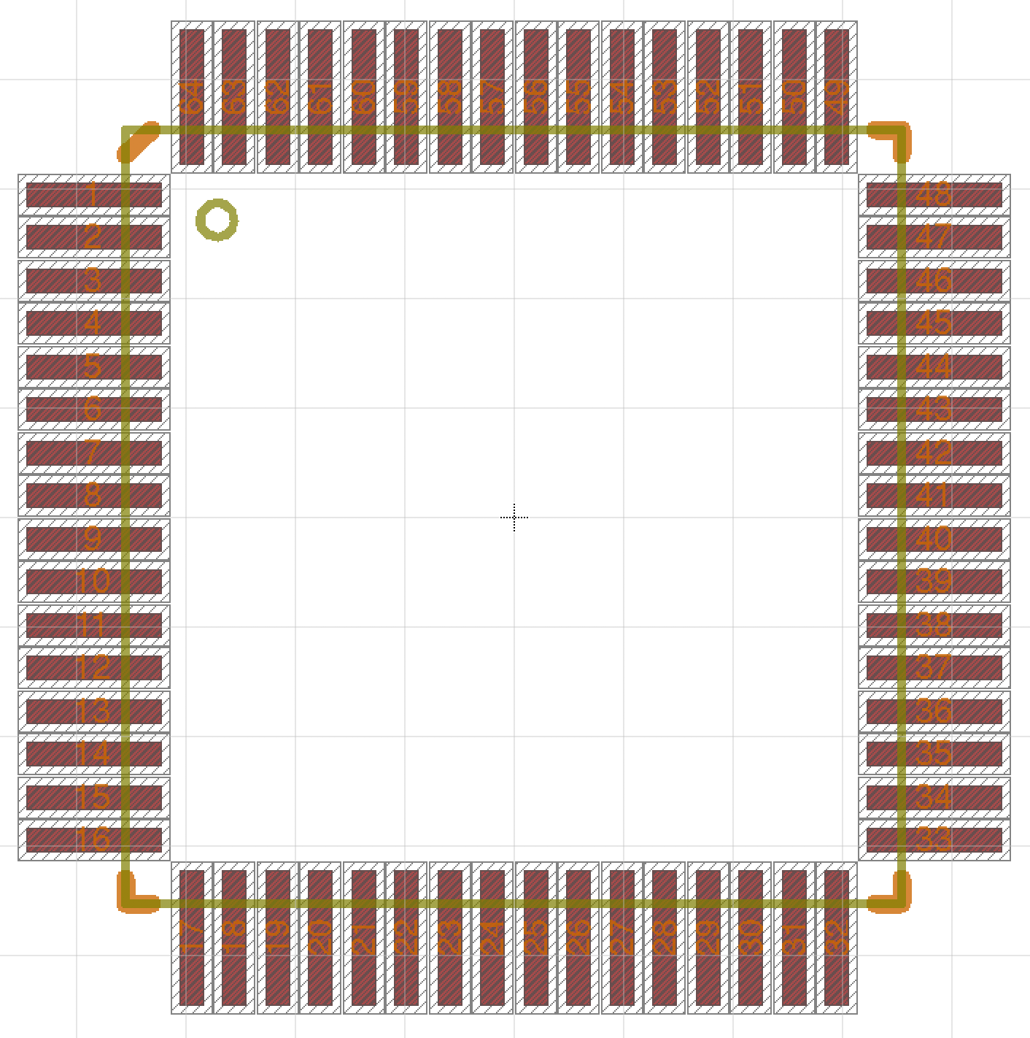
Symbol-to-Package Mapping & Metadata
Physical part
Attribute | Value
Part Number | XAU252ae-22
Manufacture | LED Inc.
Package
Symbol

Slide 22
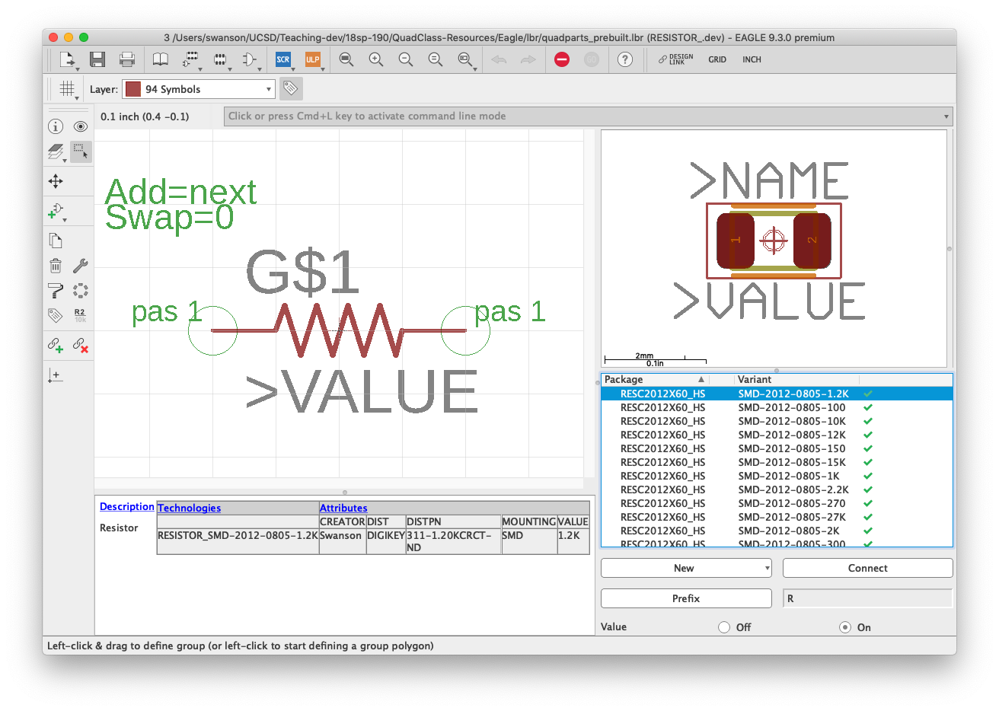
Example: A Resistor

Slide 23
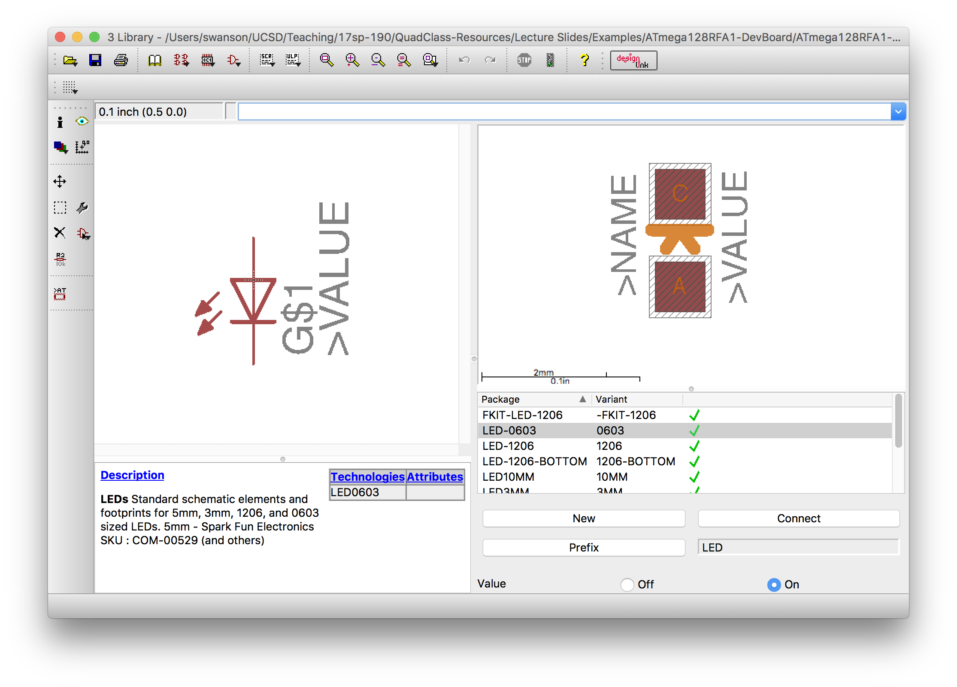
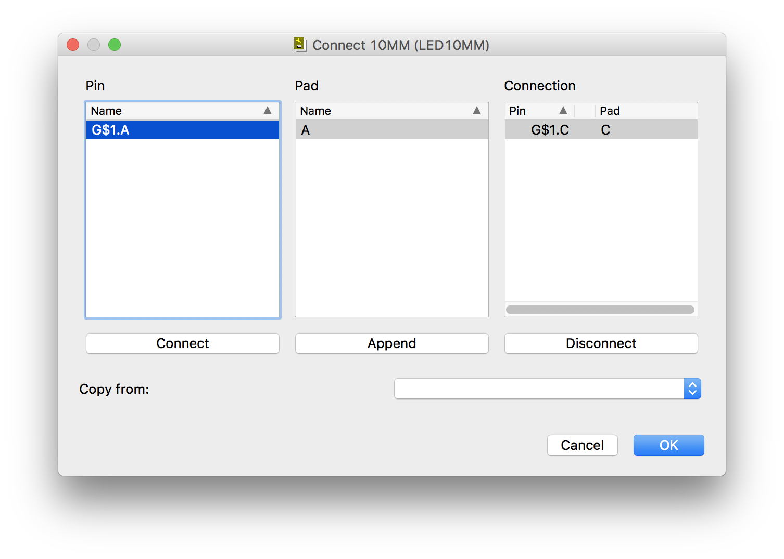
Connecting Symbol Pins to Package Pads

Slide 24
PCB Libraries: Packages, Symbols, and Devices
Dr. Steven Swanson
CSE176e/276e
swanson@cs.ucsd.edu

Slide 26
Building Parts in Fusion Lab Overview
Dr. Steven Swanson
CSE176e/276e
swanson@cs.ucsd.edu

Slide 27
A Note about tKeepout (The video doesn’t cover this enough)
Carefully designed tKeepout + a 0.5 mm placement grid is what makes laying out the board easy(ish).
Draw tkeepout on a 0.5mm grid
Keep tkeepout lines i.e., more than 1.25 grid squares but less than 2.25 from the SMDs and package bodies (or so).
Don’t obsess about these numbers.
You can “hug” the pins and package if you want.
Then inset it by 0.1mm
Set grid 0.1mm and move each line segment in 0.1mm
Fiddly but worth it.

Slide 28
tKeepout Example
Initial layout
Inset

Slide 29
tKeepout Example

Slide 30
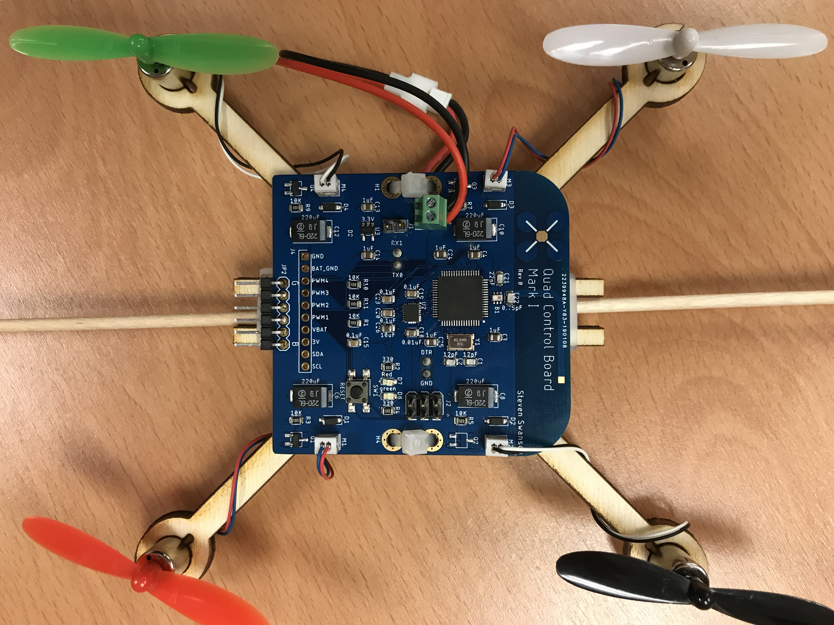
The Parts You Will Build
Resistor
LED
MOSFET
IMU

Slide 31
Datasheets
Datasheets describe electronic component.
Capabilities
Mechanical information
Size
Recommended board layout
Pin location
Electrical information
Input/output voltages
Additional required components
Schematic Applications
Examples of how to connect the part electrically
Processing information
Reflow soldering requirements
Packaging information

Slide 32
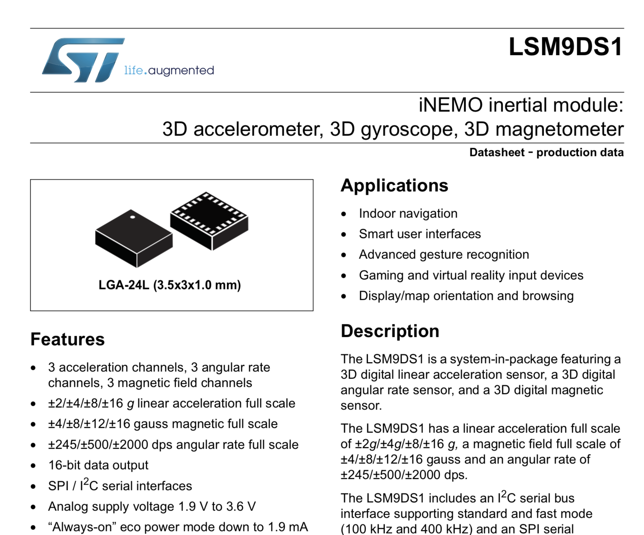

Slide 33
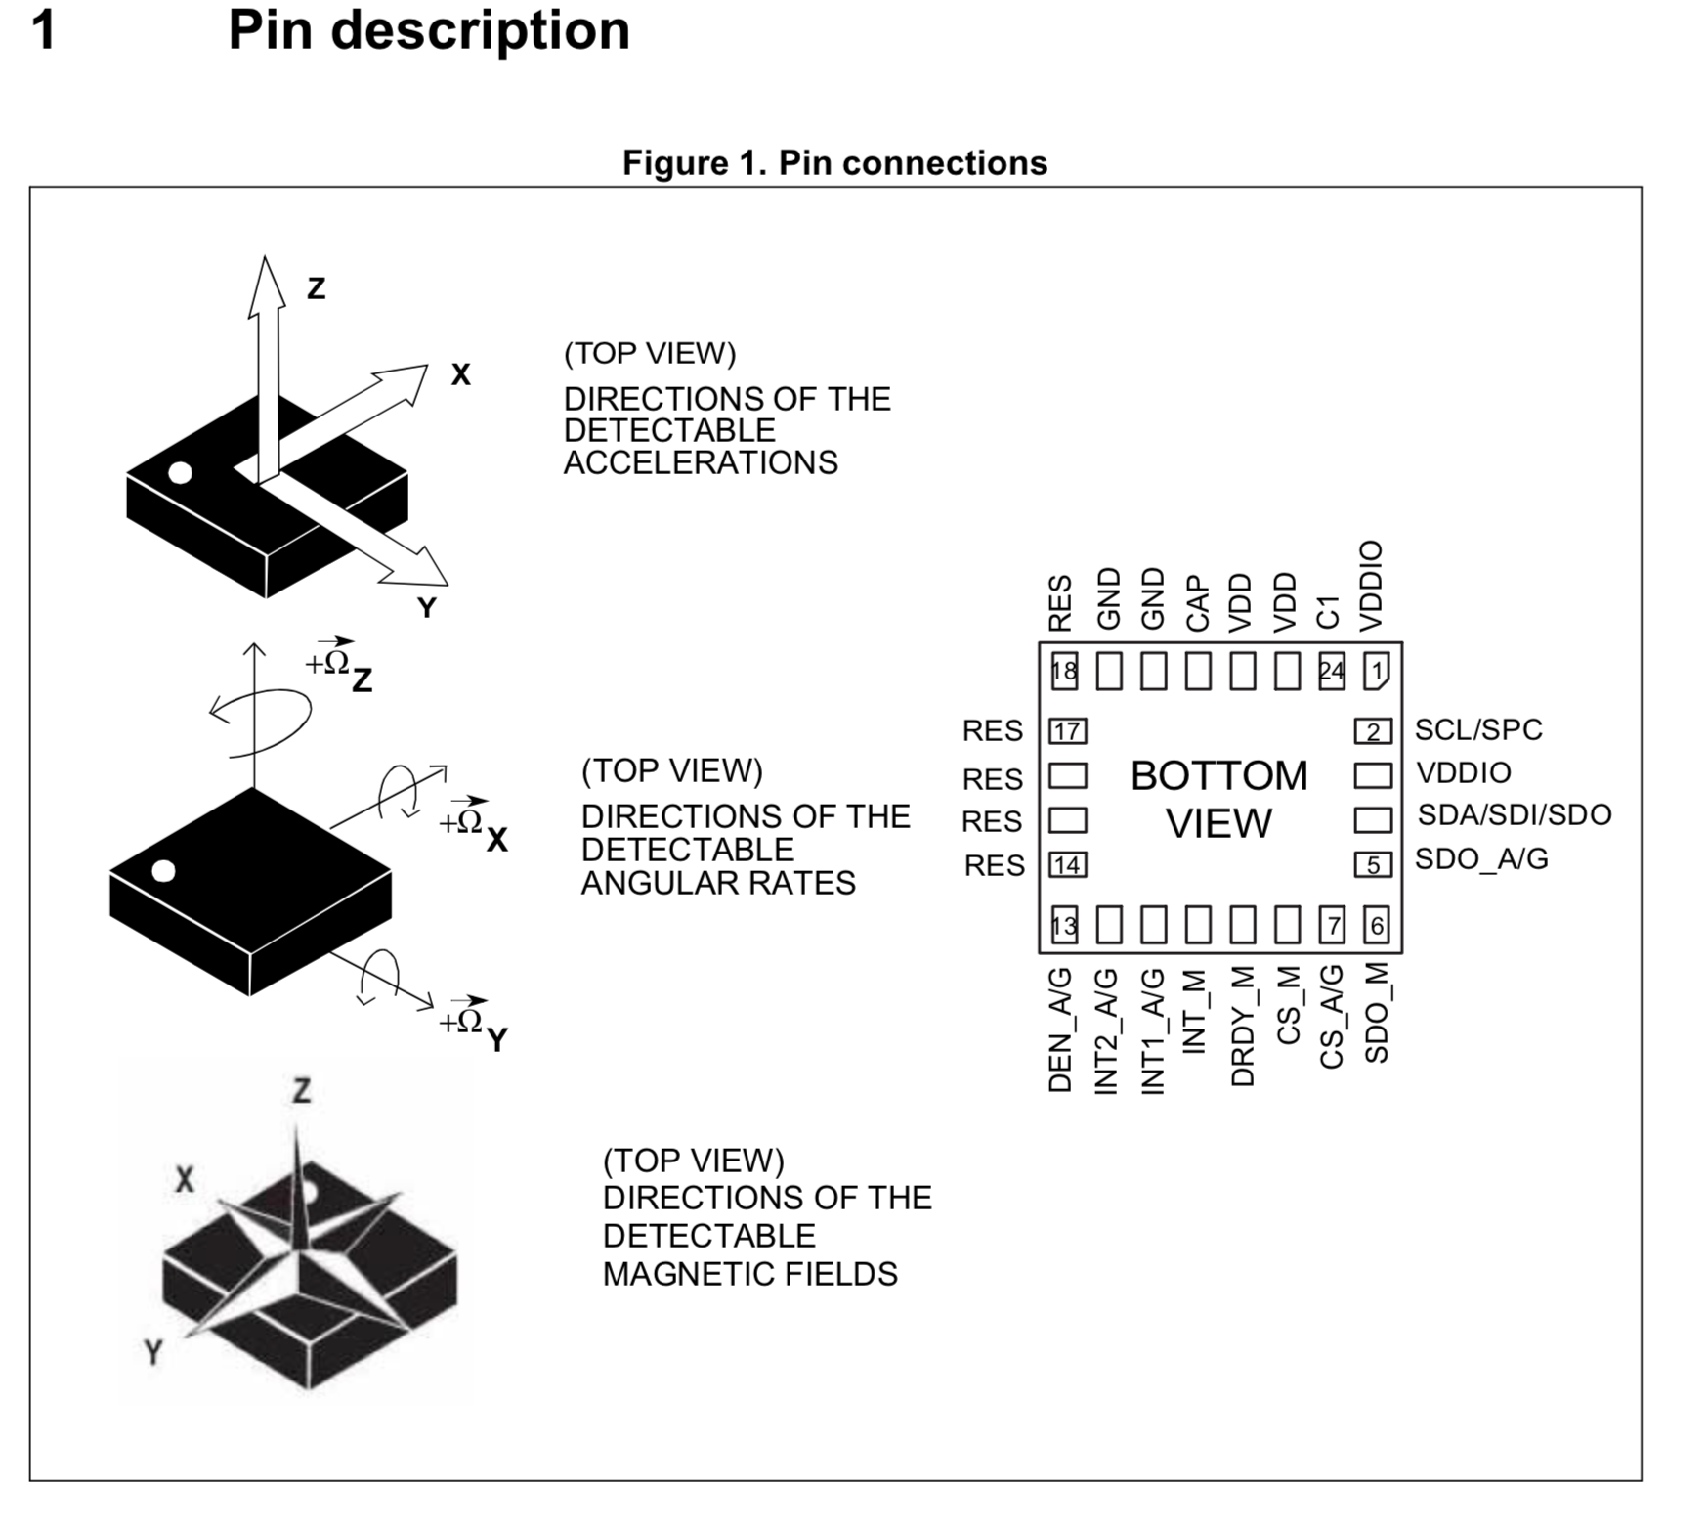

Slide 34
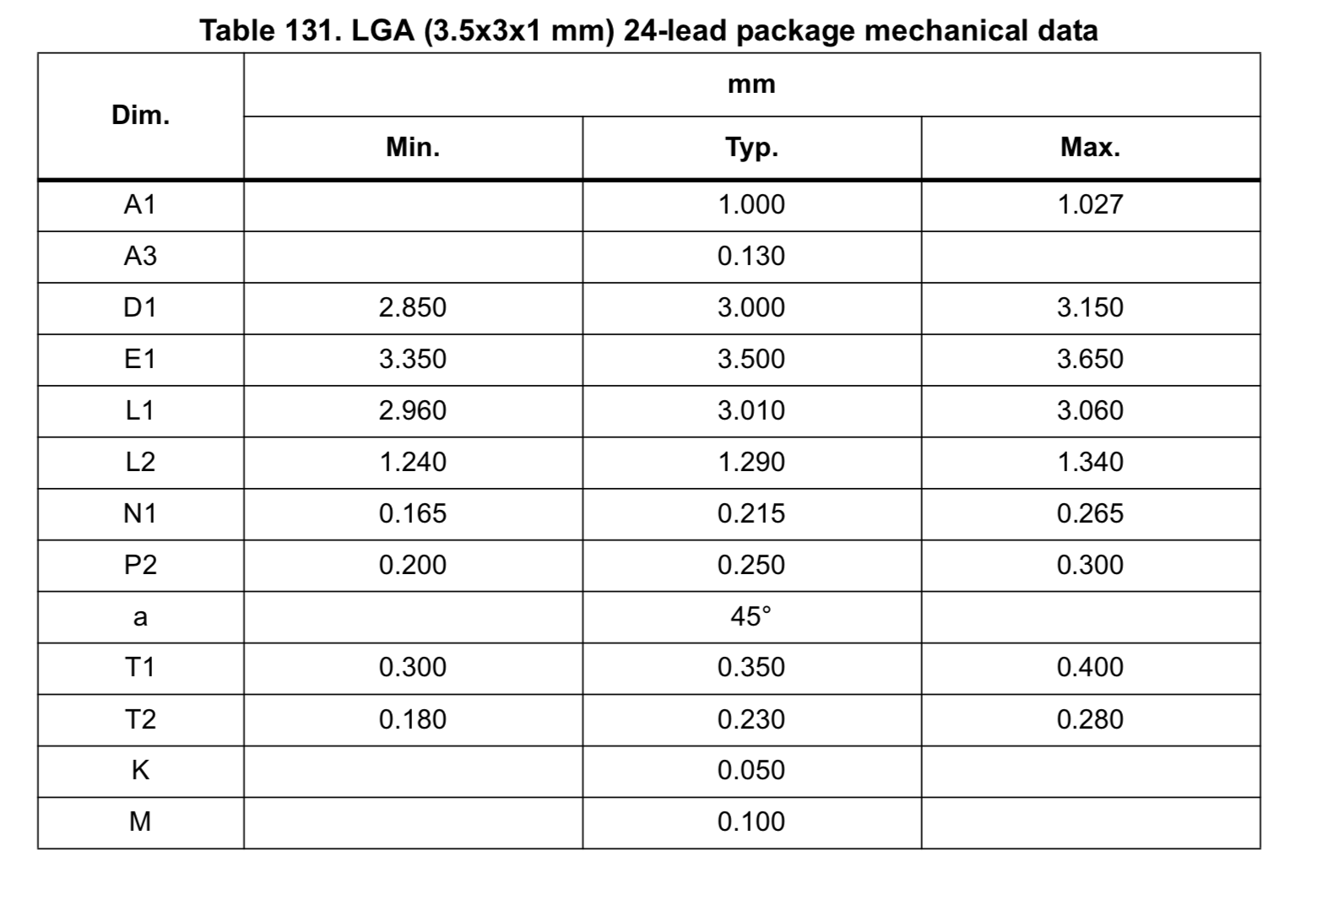
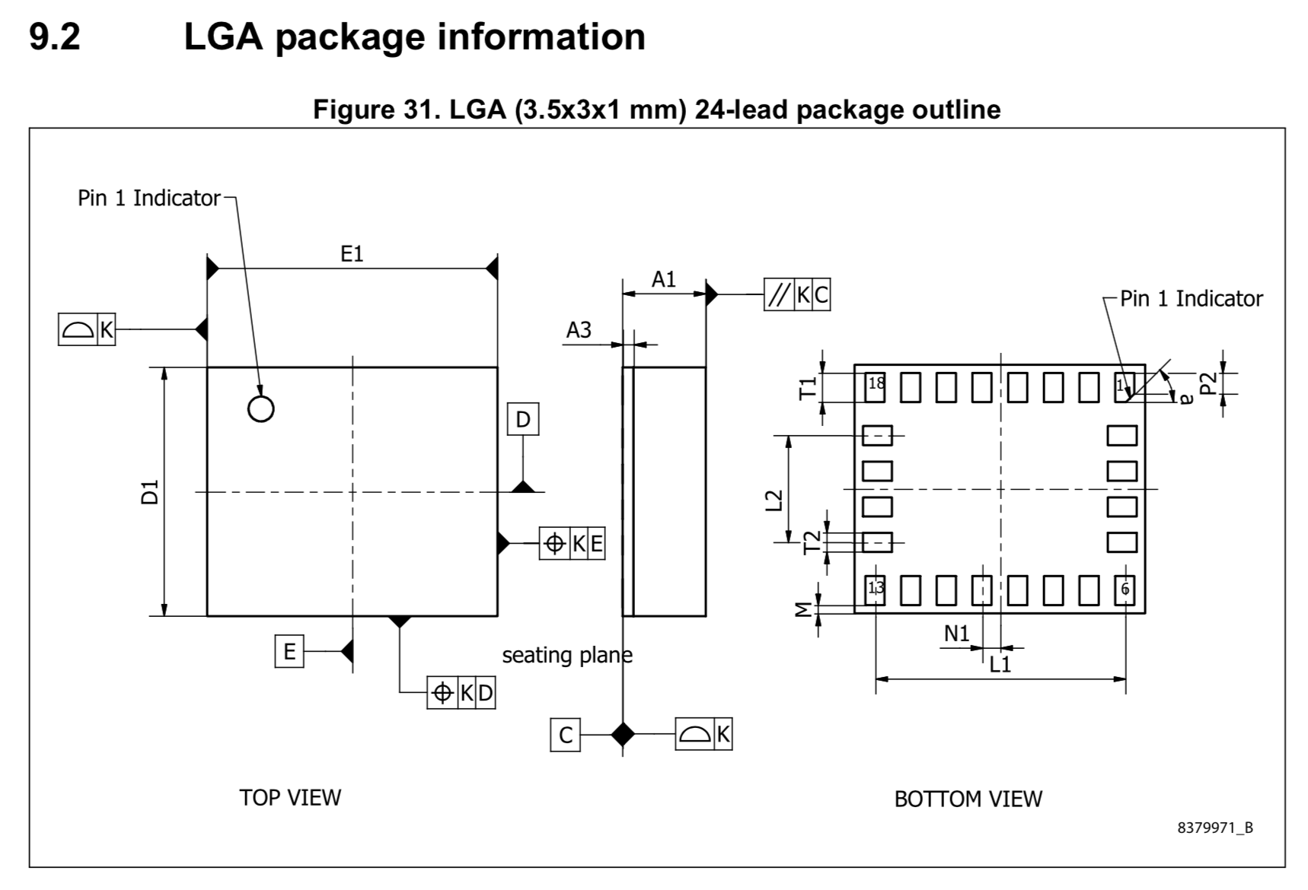

Slide 35
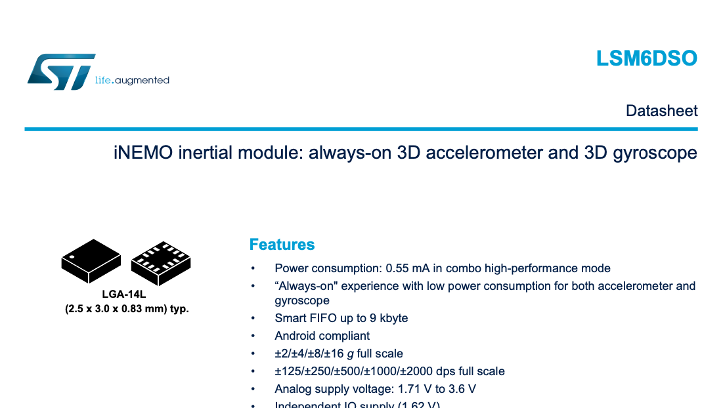

Slide 36
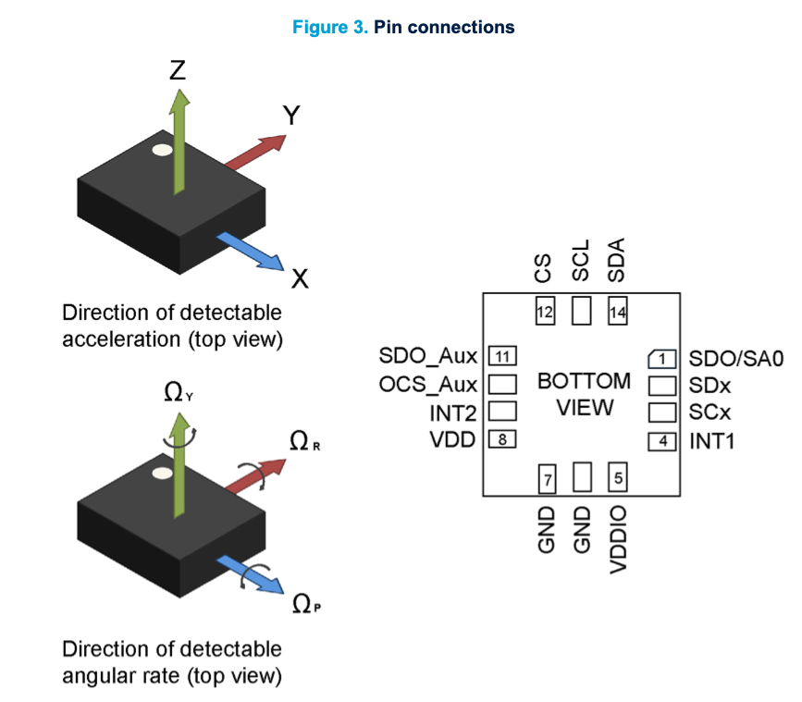

Slide 37
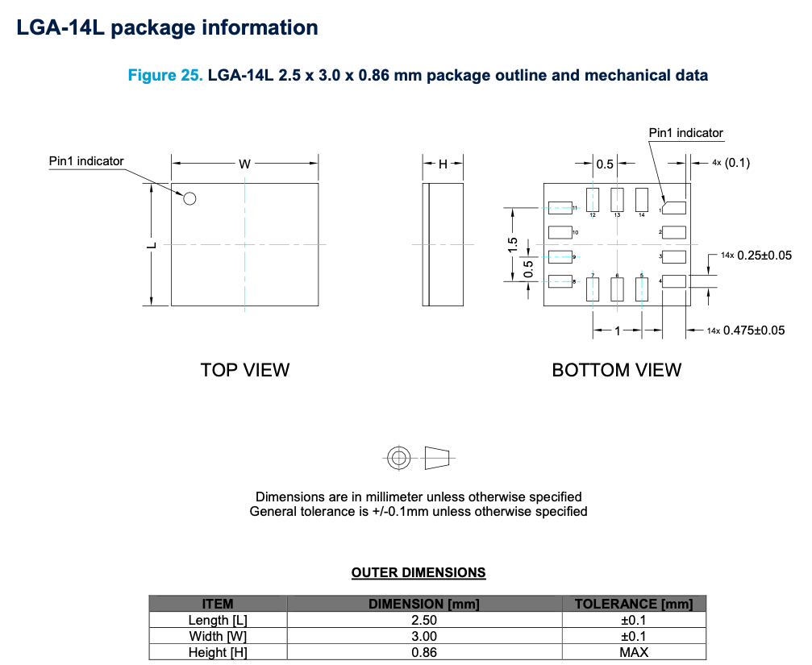

Slide 38
Tech Notes
More detailed information on some aspect of a part.
They will usually be referenced in the data sheet.
Sometimes, you just need to go looking for them.

Slide 39
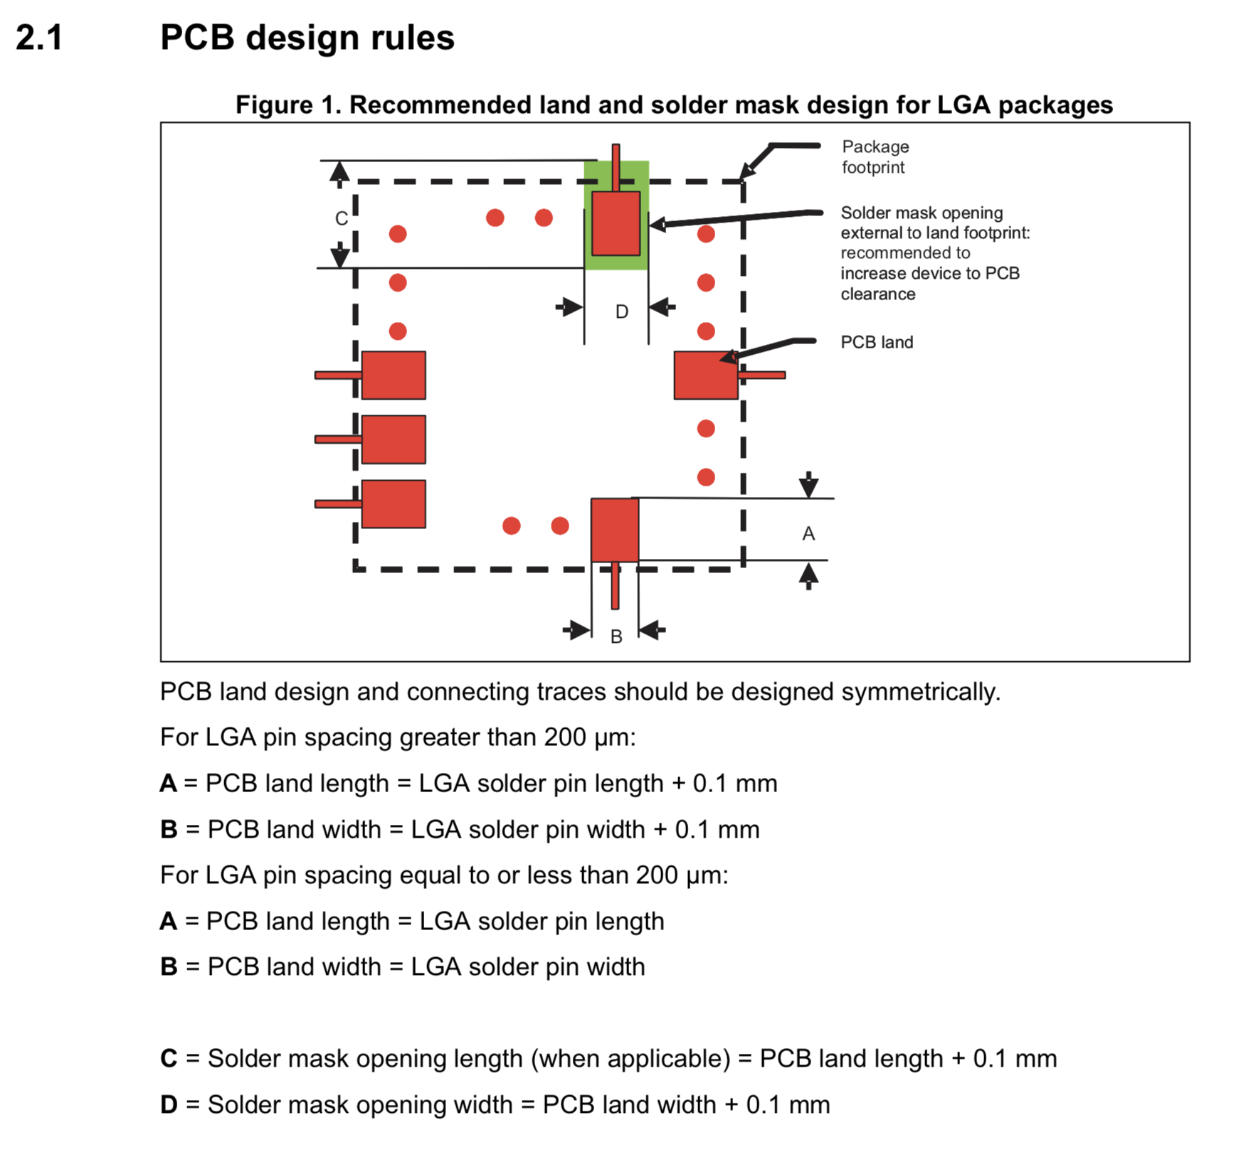
IMU Tech Notes
There are two of them in the Datasheet directory.
IMU_*
One is about LGA soldering
The other is about soldering sensors in particular.
Read them!

Slide 40
MOSFET
An electrically controlled switch
It controls the large currents to the motors
Symbol
It’s an NMOS transistor
Use google to find an appropriate symbol
Make sure you get the source and drain correct (follow the datasheet)
Package
We need large metal pads for thermal reasons
But small bits of exposed metal for soldering
Pads with large metal/small solder mask opening

Slide 41
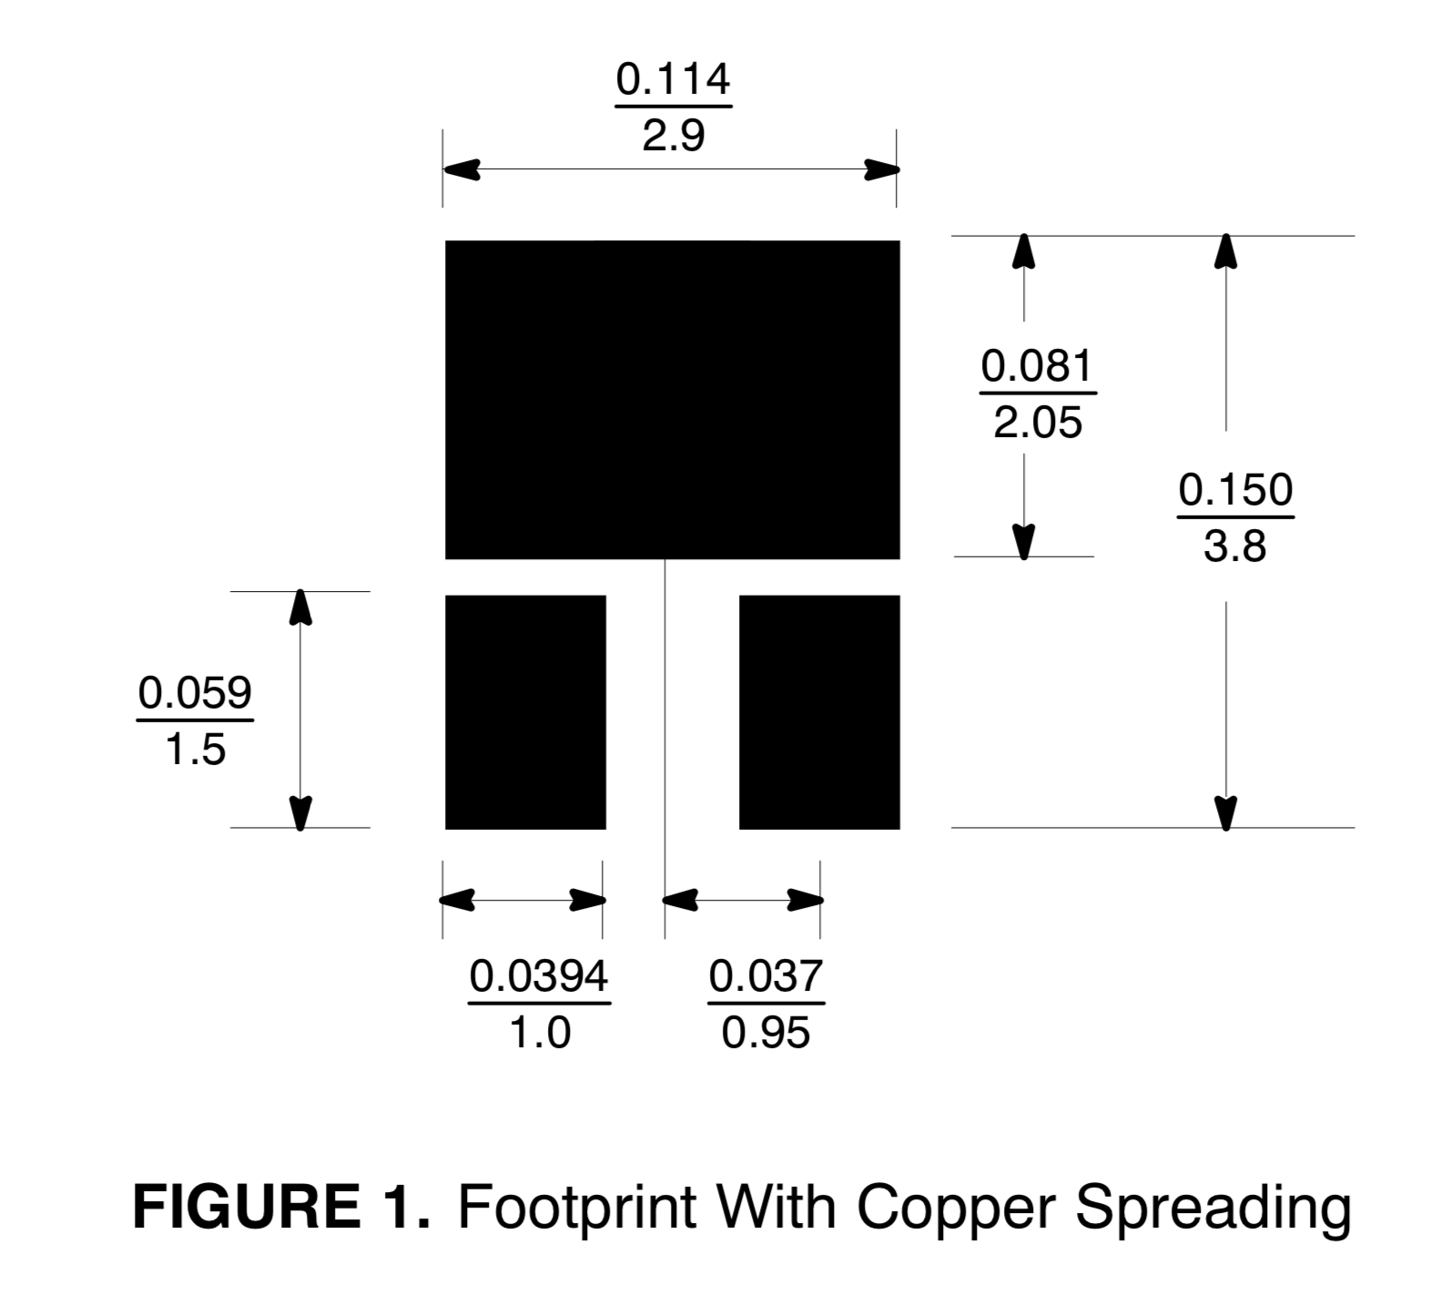
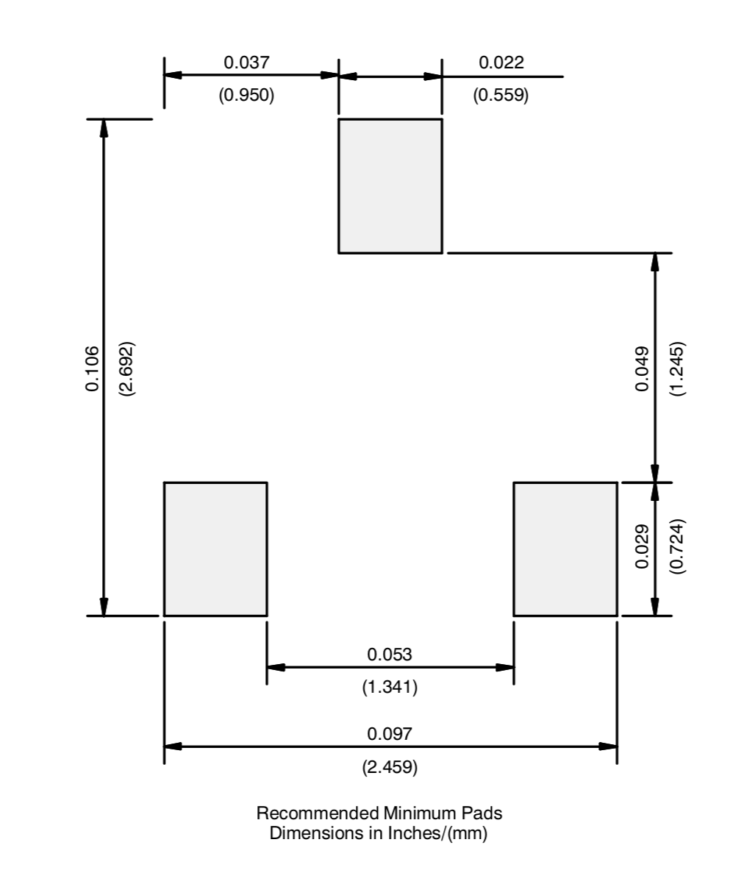
MOSFET Pad guidance in the datasheet
Metal pads
Solder mask openings

Slide 42
The LEDs
You will design your LED from scratch!
Draw an appropriate symbol (look online for examples)
Pay careful attention to orientation.
Do not confuse the cathode and the anode
Correct orientation should be clear on the schematic symbol and the package.

Slide 43
Questions?

Slide 44
Demo and Lab Walk Through
MOSFET
Part generator
Symbol
Package
Device
IMU
Symbol
Package
Device

Slide 45
Next time
Lecture was about 30 minutes of questions + 1 hour of new material.

Slide 46
Building a PCB Footprint Demo
Dr. Steven Swanson
CSE176e/276e
swanson@cs.ucsd.edu

Slide 47
Building a PCB Schematic Symbol Demo
Dr. Steven Swanson
CSE176e/276e
swanson@cs.ucsd.edu

Slide 48
Building a PCB Device Demo
Dr. Steven Swanson
CSE176e/276e
swanson@cs.ucsd.edu

